Slide 1


IPL Auction
SQL Project By Sourav Kumar Behera

Slide 2
Query for Creation Of Table
CREATE TABLE ipl_ball (
id_no int,
innings int,
over_no int,
balls int,
batsman varchar(255),
non_striker varchar(255),
bowler varchar(255),
batsman_runs int,
extra_runs int,
total_runs int,
is_wicket int,
dismissal_kind varchar(255),
player_dismissed varchar(255),
fielder varchar(255),
extra_type varchar(255),
batting_team varchar(255),
bowling_team varchar(255)
);
CREATE TABLE ipl_matches (
id_no int,
city varchar(255),
match_date date,
player_of_match varchar(255),
venue varchar(255),
neutral_venue int,
team1 varchar(255),
team2 varchar(255),
toss_winner varchar(255),
toss_decision varchar(255),
winner varchar(255),
results varchar(255),
result_margin int,
eliminator varchar(255),
methods varchar(255),
umpire1 varchar(255),
umpire2 varchar(255)
);
copy ipl_ball from 'C:\Program Files\PostgreSQL\16\data\data_copy\Data\IPL Dataset\IPL_Ball.csv' delimiter ',' csv header;
select * from ipl_ball;
copy ipl_matches from 'C:\Program Files\PostgreSQL\16\data\data_copy\Data\IPL Dataset\IPL_matches.csv' delimiter ',' csv header;
select * from ipl_matches;

Slide 3
Your first priority is to get 2-3 players with high S.R who have faced at least 500 balls. And to do that you have to make a list of 10 players you want to bid in the auction so that when you try to grab them in auction you should not pay the amount greater than you
have in the purse for a particular player.
SELECT
batsman,
SUM(batsman_runs) AS Total_runs,
COUNT(balls) AS Balls_faced,
ROUND((SUM(batsman_runs) * 100.0) / COUNT(balls), 2) AS Strike_rate
FROM
ipl_Ball
WHERE
extra_type != 'wides'
GROUP BY
batsman
HAVING
COUNT(balls) >= 500
ORDER BY
Strike_rate DESC
LIMIT 10;

Slide 4
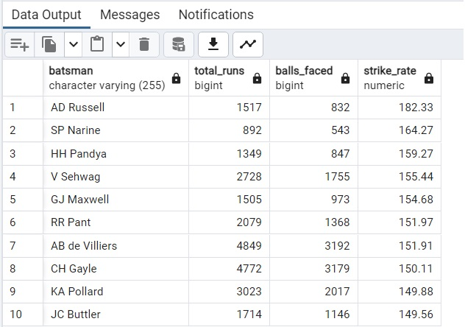
Bidding on Batting
List of 10 players with high strike rate who have faced at least 500 balls
Name of 3 players to bid on with Highest Strike Rate:
AD Russell
SP Narine
HH Pandya

Slide 5
Now you need to get 2-3 players with good Average who have played more than 2 ipl seasons. And to do that you have to make a list of 10 players you want to bid in the auction so that when you try to grab them in auction you should not pay the amount greater than you have in the purse for a particular player.
SELECT
b.batsman,
COUNT(DISTINCT EXTRACT(YEAR FROM m.match_date)) AS season_played,
SUM(b.batsman_runs) AS total_runs,
SUM(CASE WHEN b.is_wicket = 1 THEN 1 ELSE 0 END) AS wicket_ball,
SUM(b.batsman_runs) / NULLIF(SUM(CASE WHEN b.is_wicket = 1 THEN 1 ELSE 0 END), 0) AS Batting_average
FROM
IPL_Ball b
INNER JOIN
IPL_Matches m ON b.id_no = m.id_no
GROUP BY
b.batsman
HAVING
COUNT(DISTINCT EXTRACT(YEAR FROM m.match_date)) > 2
AND COUNT(b.balls) > 500
ORDER BY
Batting_average DESC
LIMIT 10;

Slide 6
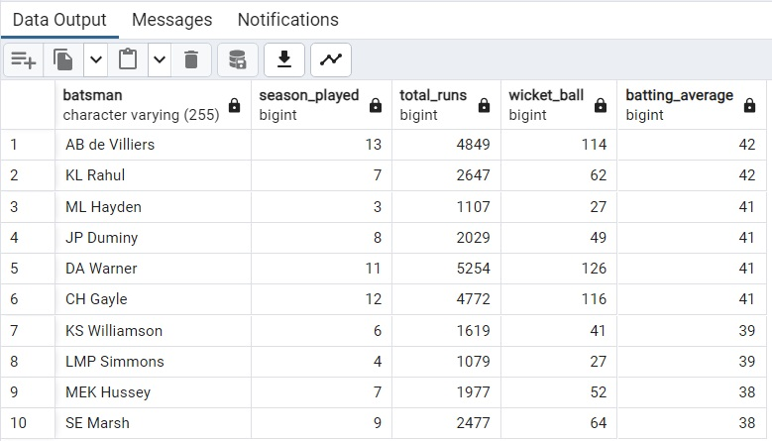
List of 10 players with good average rate who have played more than 2 IPL seasons
Name of 3 players with Best average
AB de Villiers
KL Rahul
ML Hayden

Slide 7
Now you need to get 2-3 Hard-hitting players who have scored most runs in boundaries and have played more the 2 ipl season. To do that you have to make a list of 10 players you want to bid in the auction so that when you try to grab them in auction you should not pay the amount greater than you have in the purse for a particular player.
SELECT
a.batsman,
a.batting_team,
COUNT(DISTINCT EXTRACT(YEAR FROM b.match_date)) AS season_played,
SUM(a.batsman_runs) AS total_runs,
SUM(CASE WHEN a.batsman_runs IN (4, 6) THEN 1 ELSE 0 END) AS total_boundaries
FROM
IPL_Ball AS a
INNER JOIN IPL_Matches AS b ON a.id_no = b.id_no
GROUP BY
a.batsman, a.batting_team
HAVING
COUNT(DISTINCT EXTRACT(YEAR FROM b.match_date)) > 2
AND SUM(CASE WHEN a.batsman_runs IN (4, 6) THEN 1 ELSE 0 END) > 0
ORDER BY
total_boundaries DESC
LIMIT 10;

Slide 8
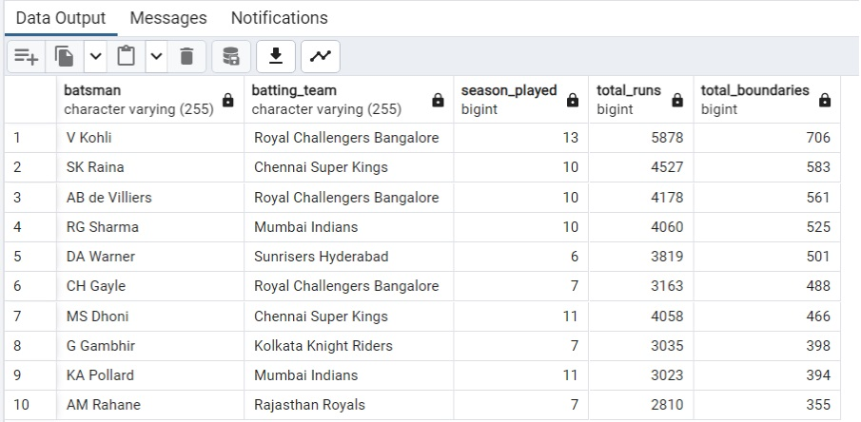
Top 10 Hard Hitting Players Who Have Played More Than 2 Seasons
3 Hard-hitting players to bid on who have scored most runs in boundaries and have played more the 2 IPL season
Virat Kohli
SK Raina
AB De Villiers

Slide 9
Your first priority is to get 2-3 bowlers with good economy who have bowled at least 500 balls in IPL so far. To do that you have to make a list of 10 players you want to bid in the auction so that when you try to grab them in auction you should not pay the amount greater than you have in the purse for a particular player.
SELECT
a.bowler,
COUNT(DISTINCT EXTRACT(YEAR FROM b.match_date)) AS seasons_played,
SUM(a.balls) AS total_balls,
SUM(a.total_runs) AS total_runs,
ROUND(SUM(a.balls) / 6.0, 0) AS total_overs,
ROUND(SUM(a.total_runs) / (SUM(a.balls) / 6.0), 2) AS economy
FROM
ipl_ball AS a
INNER JOIN ipl_matches AS b ON a.id_no = b.id_no
GROUP BY
a.bowler
HAVING
SUM(a.balls) >= 500
ORDER BY
economy ASC
LIMIT 10;

Slide 10
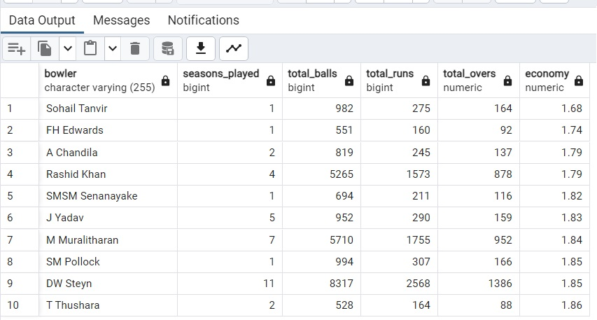
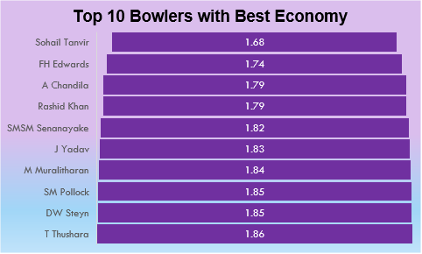
List of 10 players with Best economy who have bowled at least 500 balls in IPL so far
3 bowlers with Best economy who have bowled at least 500 balls in IPL
1) Sohail Tanvir
2)FH Edwards
3) A Chandila

Slide 11
Now you need to get 2-3 bowlers with the best strike rate and who have bowled at least 500 balls in IPL so far. To do that you have to make a list of 10 players you want to bid in the auction so that when you try to grab them in auction you should not pay the amount greater than you have in the purse for a particular player.
SELECT
bowler,
SUM(total_runs) AS total_runs_given,
ROUND(SUM(total_balls) / 6, 0) AS total_overs_bowled,
SUM(CASE WHEN is_wicket = 1 THEN 1 ELSE 0 END) AS total_wickets,
ROUND(SUM(total_balls) / NULLIF(SUM(CASE WHEN is_wicket = 1 THEN 1 ELSE 0 END), 0), 2) AS strike_rate
FROM
(
SELECT
bowler,
SUM(batsman_runs) AS total_runs,
COUNT(balls) AS total_balls,
SUM(CASE WHEN dismissal_kind IN ('caught', 'lbw', 'bowled') THEN 1 ELSE 0 END) AS is_wicket
FROM
IPL_Ball
WHERE
extra_type != 'wide'
GROUP BY
bowler, id_no
) AS bowler_stats
GROUP BY
bowler
HAVING
SUM(total_balls) >= 500
ORDER BY
strike_rate ASC
LIMIT 10;

Slide 12
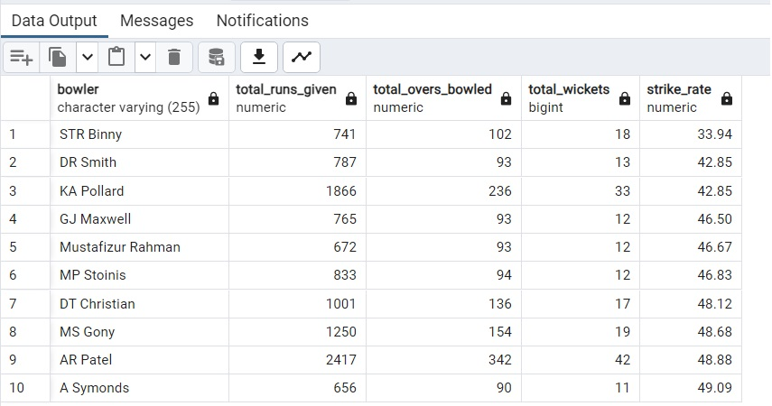
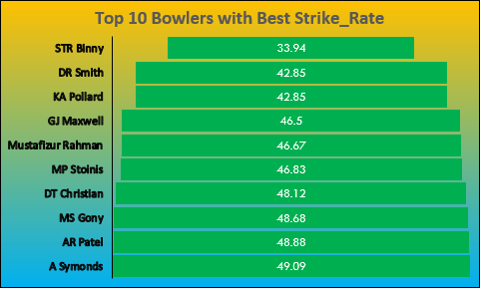
List of 10 Bowlers with Best Strike Rate
Top 3 Bowlers With Best Strike Rate
STR Binny
DR Smith
KA Pollard

Slide 13
Now you need to get 2-3 All_rounders with the best batting as well as bowling strike rate and who have faced at least 500 balls in IPL so far and have bowled minimum 300 balls.To do that you have to make a list of 10 players you want to bid in the auction so that when you try to grab them in auction you should not pay the amount greater than you have in the purse for a particular player.
WITH AllRounderStats AS (
SELECT
batsman,
COUNT(*) AS balls_faced,
SUM(batsman_runs) AS total_runs
FROM
IPL_Ball
GROUP BY
batsman
HAVING
COUNT(*) >= 500),
BowlerStats AS (
SELECT
bowler,
COUNT(*) AS balls_bowled,
COUNT(CASE WHEN is_wicket = 1 THEN 1 END) AS total_wickets
FROM
IPL_Ball
GROUP BY
bowler
HAVING
COUNT(*) >= 300),
AllRounders AS (
SELECT
a.batsman,
a.total_runs,
a.balls_faced,
b.balls_bowled,
b.total_wickets,
ROUND(a.total_runs * 100.0 / NULLIF(a.balls_faced, 0), 2) AS batting_strikerate,
ROUND(b.balls_bowled * 1.0 / NULLIF(b.total_wickets, 0), 2) AS bowling_strikerate
FROM
AllRounderStats a
JOIN
BowlerStats b ON a.batsman = b.bowler)
SELECT
batsman,
batting_strikerate,
bowling_strikerate
FROM
AllRounders
ORDER BY
batting_strikerate DESC, bowling_strikerate ASC
LIMIT 10;

Slide 14
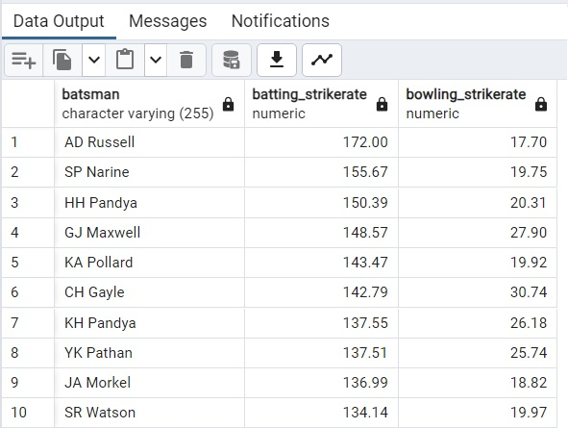
List of 10 players with All Rounders with the best batting as well as bowling strike rate and who have faced at least 500 balls in IPL so far and have bowled minimum 300 balls.
Top 3 All Rounders In IPL
AD Russel
SP Narine
HH Pandya

Slide 15
Criteria For Wicket Keeper
In choosing our T20 team's wicketkeeper, we have set specific criteria to find a player
who fits well in the fast-paced nature of this format.
Wicketkeeping Skills:
Catches and Stumpings: We're looking for a player who has taken most number of catches and done most no of stumping but at least 50 catches and 50 stumpings, showing excellence in securing dismissals.
Batting Ability:
Minimum Balls Faced: The candidate should have faced a minimum of 500 deliveries,
indicating their ability to stay at the crease.(Ball Faced>500)
High Strike Rate: We prefer a player with a good batting strike rate, meaning they score quickly.(Total runs scored divided by total ball faced excluding wides).
Scoring Style:
Runs from Boundaries: We want a player whose runs mostly come from boundaries, specifically, 4s and 6s, showcasing an aggressive batting style.(only 4 and 6 runs is counted as hits and then compare how much percentage of runs he scored by boundaries)
Bowling Contributions:
Bowled Over 300 Balls: If the player has bowled more than 300 balls, (balls bowled >300)
it adds an extra dimension to our team's strategy.
Decision Making-Ability to make successful DRS Decision. (percentage of no of successful DRS calls divided by No of DRS calls taken). This will give us the percentage he got succeeded.
These simple criteria aim to find a wicketkeeper who not only excels at dismissals
but also contributes effectively to scoring runs and provides strategic options in T20 matches.

Slide 16
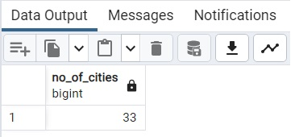
1. Get the count of cities that have hosted an IPL match
select count(distinct city) as No_Of_cities from ipl_matches;

Slide 17
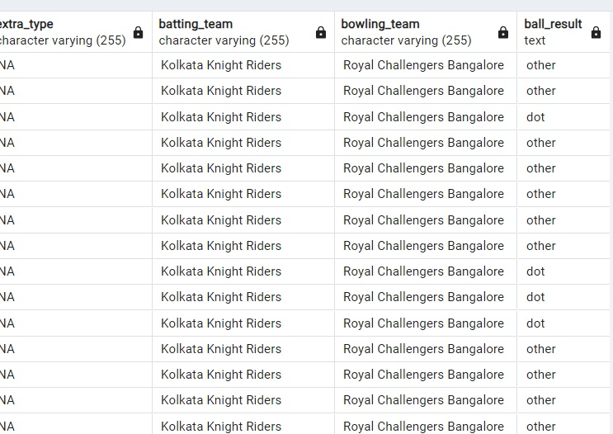
2. Create table deliveries_v02 with all the columns of the table ‘deliveries’ and an additional
column ball_result containing values boundary, dot or other depending on the total_run
(boundary for >= 4, dot for 0 and other for any other number)
(Hint 1 : CASE WHEN statement is used to get condition based results)
(Hint 2: To convert the output data of the select statement into a table, you can use a
subquery. Create table table_name as [entire select statement].
CREATE TABLE deliveries_v02 AS
SELECT *,
CASE
WHEN total_runs >= 4 THEN 'boundary'
WHEN total_runs = 0 THEN 'dot'
ELSE 'other'
END AS ball_result
FROM ipl_ball;

Slide 18
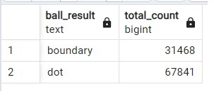
3. Write a query to fetch the total number of boundaries and dot balls from the deliveries_v02 table.
SELECT
ball_result,
COUNT(*) AS total_count
FROM
deliveries_v02
WHERE
ball_result IN ('boundary', 'dot')
GROUP BY
ball_result;

Slide 19
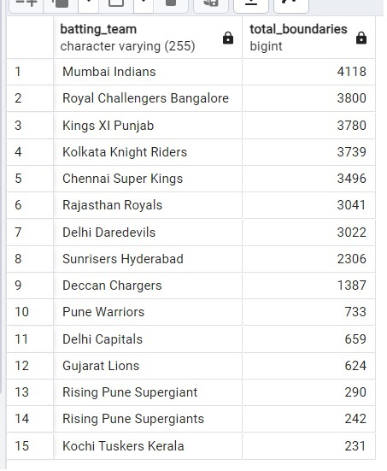
4. Write a query to fetch the total number of boundaries scored by each team from the deliveries_v02 table and order it in descending order of the number of boundaries scored.
SELECT
batting_team,
COUNT(*) AS total_boundaries
FROM deliveries_v02
WHERE
ball_result = 'boundary'
GROUP BY
batting_team
ORDER BY total_boundaries DESC;

Slide 20
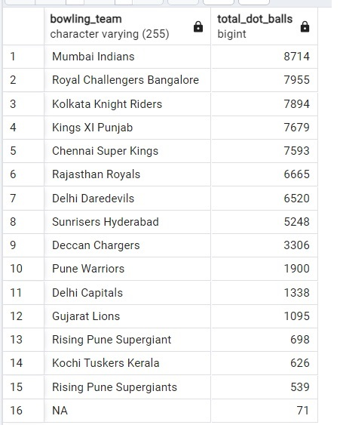
5. Write a query to fetch the total number of dot balls bowled by each team and order it in descending order of the total number of dot balls bowled.
SELECT
bowling_team,
COUNT(*) AS total_dot_balls
FROM
deliveries_v02
WHERE
ball_result = 'dot'
GROUP BY
bowling_team
ORDER BY
total_dot_balls DESC;

Slide 21
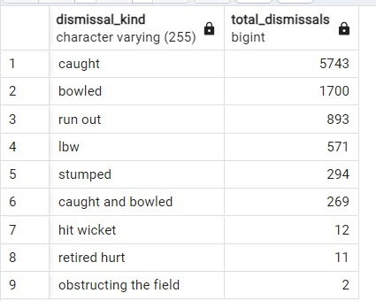
6. Write a query to fetch the total number of dismissals by dismissal kinds where dismissal kind is not NA
SELECT
dismissal_kind,
COUNT(*) AS total_dismissals
FROM
deliveries_v02
WHERE
dismissal_kind IS NOT NULL
AND dismissal_kind != 'NA'
GROUP BY
dismissal_kind
ORDER BY
total_dismissals DESC;

Slide 22
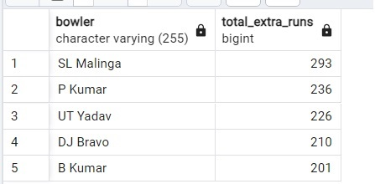
7. Write a query to get the top 5 bowlers who conceded maximum extra runs from the deliveries table
SELECT
bowler,
SUM(extra_runs) AS total_extra_runs
FROM
ipl_ball
GROUP BY
bowler
ORDER BY
total_extra_runs DESC
LIMIT 5;

Slide 23
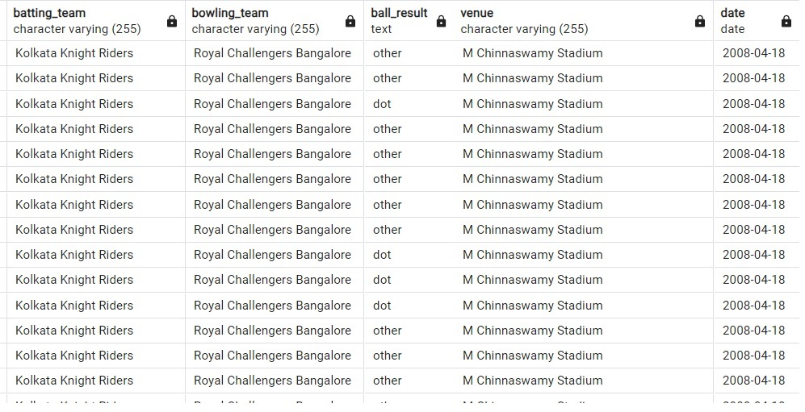
8. Write a query to create a table named deliveries_v03 with all the columns of deliveries_v02 table and two additional column (named venue and match_date) of venue and date from table matches
CREATE TABLE deliveries_v03 AS
SELECT
a.*,
b.venue,
b.match_date AS date
FROM
deliveries_v02 AS a
JOIN
IPL_Matches AS b ON a.id_no = b.id_no;

Slide 24
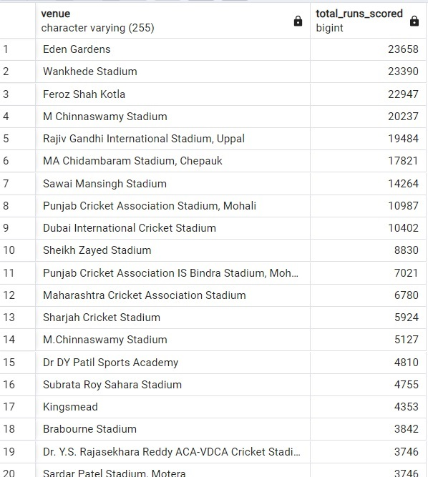
9. Write a query to fetch the total runs scored for each venue and order it in the descending order of total runs scored.
SELECT
venue,
SUM(total_runs) AS total_runs_scored
FROM
deliveries_v03
GROUP BY
venue
ORDER BY
total_runs_scored DESC;

Slide 25
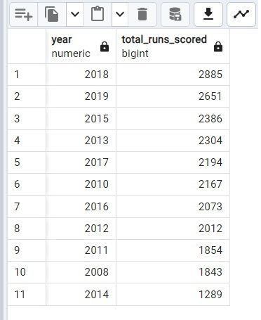
10. Write a query to fetch the year-wise total runs scored at Eden Gardens and order it in the
descending order of total runs scored.
SELECT
EXTRACT(YEAR FROM date) AS year,
SUM(total_runs) AS total_runs_scored
FROM
deliveries_v03
WHERE
venue = 'Eden Gardens'
GROUP BY
year
ORDER BY
total_runs_scored DESC;

Slide 26
THANK YOU FOR WATCHING

